Slide 1

Pipeline Orchestration
Azure Data Factory

Slide 2
Prerequisites
Active Azure Account Subscription: If you are logging into Azure for the first time, an Azure free subscription for a month is available. This subscription provides access to Azure services and resources, including Blob Storage and Azure Data Factory.
Azure Blob Storage Account: Create an Azure Blob Storage account within your Azure subscription. This account serves as the repository for storing various types of data, including the data files to be loaded.
Azure Data Factory: Ensure access to Azure Data Factory, a cloud-based data integration service used for orchestrating and automating data movement and transformation workflows. It plays a significant role in this data-loading process.
Azure SQL Server and SQL Database are also Provisioned

Slide 3
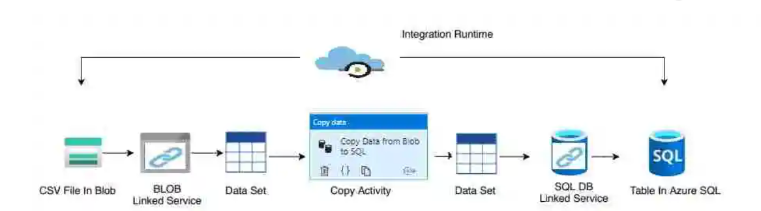
Project
We extract the data from Blob Storage
Perform the data transformations and data flow process can trigger and process the data and put the data in SQL Database
Assume that we have the source as the CSV file available in the Azure Blob storage location and we want to move the CSV data to the table in Azure SQL Database.

Slide 4
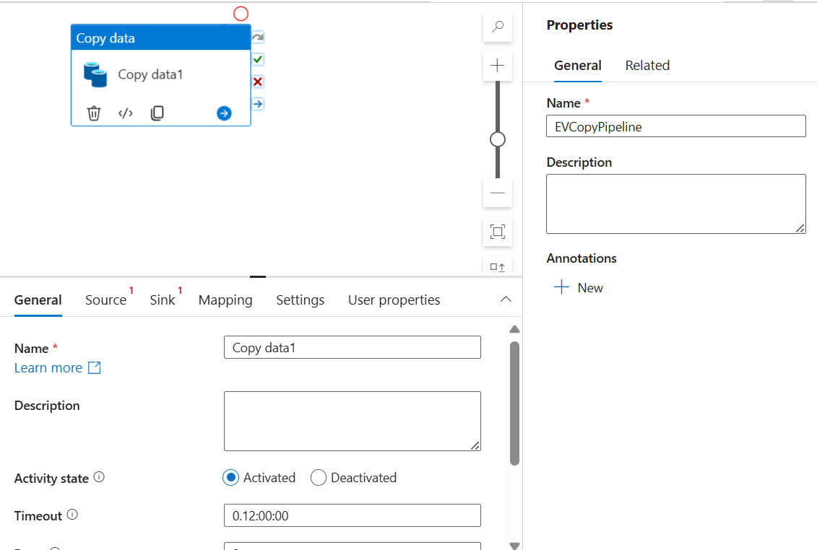
1. EVCopyPipeline: Extract data from source
Go to the author tab and again click on the + sign. This time create the pipeline, you can give the pipeline name and their description.
Now go to the activity box and search for the copy activity, you will see the copy activity just drag and drop into the canvas.
We will now start doing the configuration for this copy activity. Once you select this copy activity within the canvas, in the bottom you will see the multiple tabs.

Slide 5
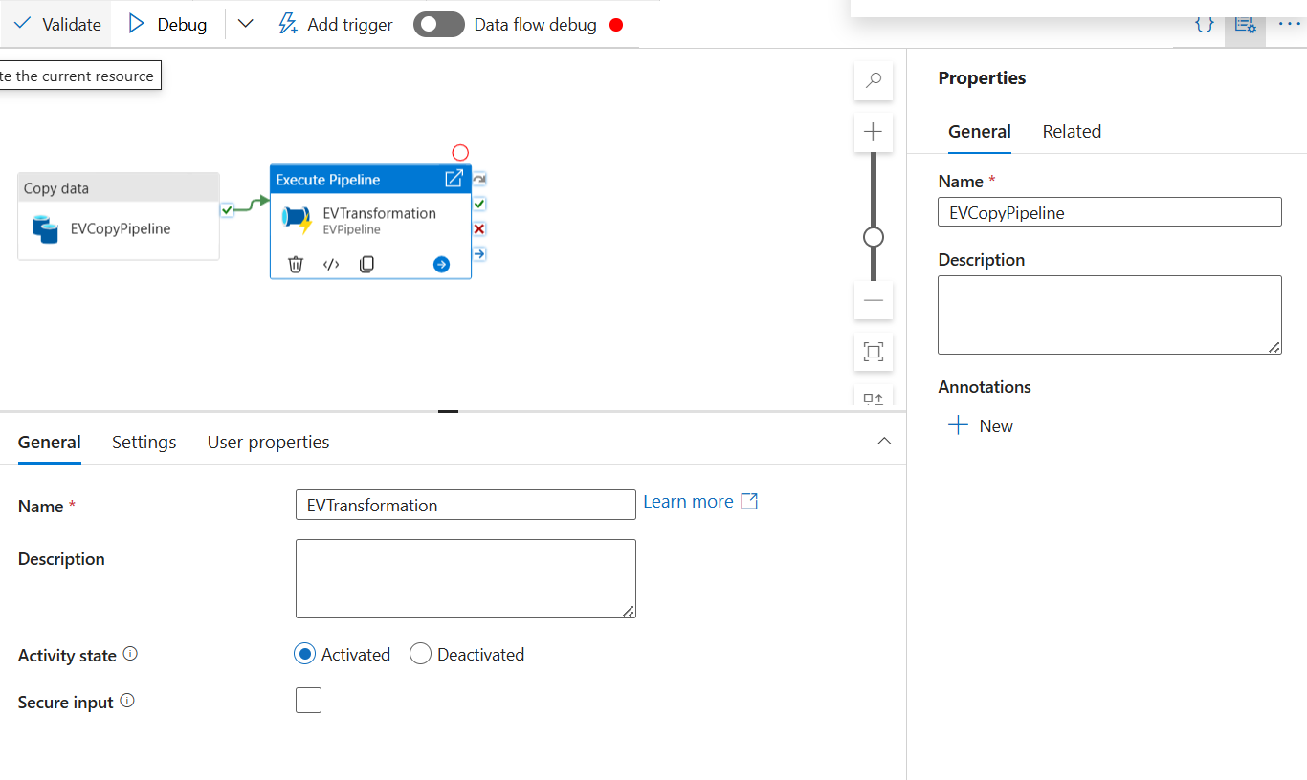
Executing the Pipeline
Once the data is extracted from source, we are executing the pipeline on success which transforms the data and put the data in Database

Slide 6
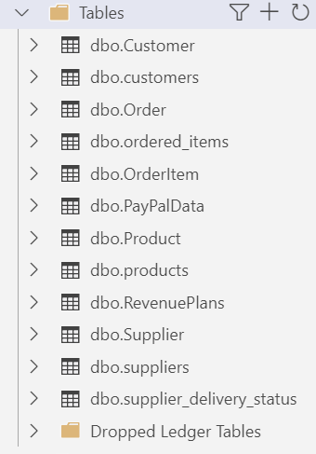
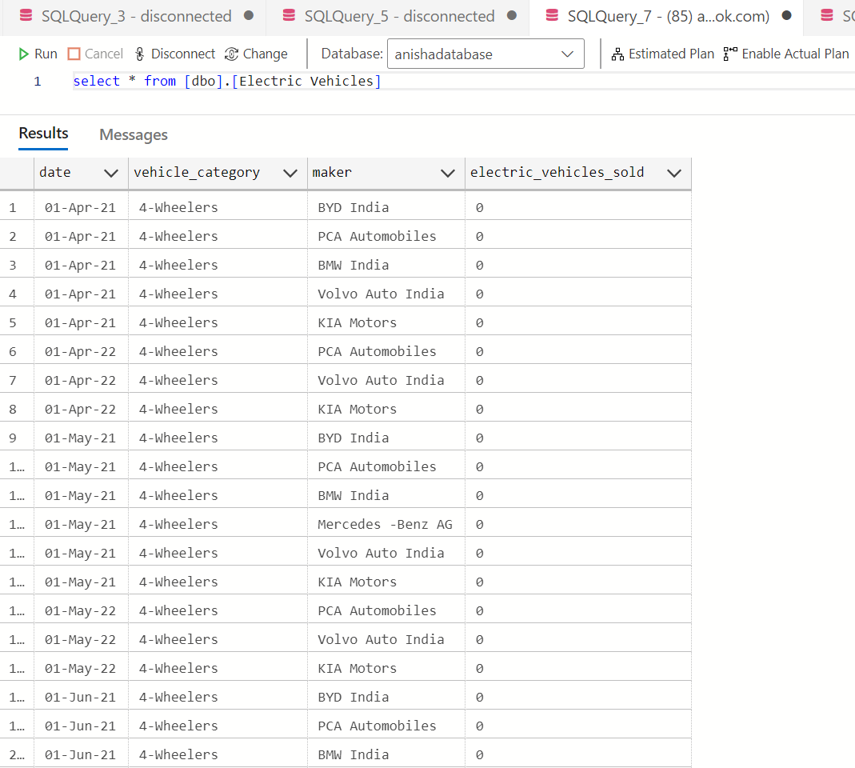
Before Pipeline execution
After Pipeline run successfully data moved to database

